Slide 1

BLACK FRIDAY SALES
BY: RAJSHRI TOTLA

Slide 2
About
Black Friday sales dataset
By Retail Stores
550,000 observations
Contains:
Numerical Variables
Categorical Variables
Some missing values

Slide 3
Process
Downloaded data (from kaggle)
Data Gathering
Exploring Data
Cleaning Data
Final Formatting of Data

Slide 4
R Packages Used
UsingR
sampling
stringr
tidyverse
stats
prob
dbplyr
dtplyr

Slide 5
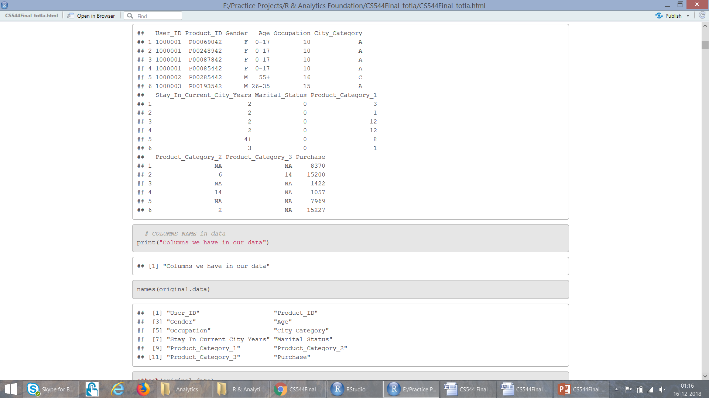
Attributes in Data
User_ID (Numerical Variable)
Product_ID (Categorical Variable)
Gender (Categorical Variable)
Age (Categorical Variable, because it is in ranges)
Occupation (Numerical Variable)
City_Category (Categorical Variable)
Stay_In_Current_City_Years (Numerical Variable)
Marital_Status (Numerical Variable)
Product_Category_1 (Numerical Variable)
Product_Category_2 (Numerical Variable)
Product_Category_3 (Numerical Variable)
Purchase amount in dollars (Numerical Variable)

Slide 6
Exploring Attributes
User Id: Not Unique, maps person to the particular purchase
Product Id: Not Unique, tells how many purchases are made for a product
Gender: Have only two variables: F M
Age: It is divided into 7 ranges, Here Age is Categorical Variable
Occupation: There are 21 different occupation ranging from 0-21
City Category: Cities in which customers have lived is categorized into three categories: A, B, C
Year.. : People have lived in the current city for 0-5 years. Here 5 could mean atleast 5 years
Marital Status: People have their marriage status marked as either 0 or 1
Product Category 1: Ranges form 1-18
Product Category 2: Ranges form 2-18
Product Category 3: Ranges form 3-18
Purchase: It is the amount people spent in $ for purchases. Not unique.

Slide 7
Analysis..

Slide 8
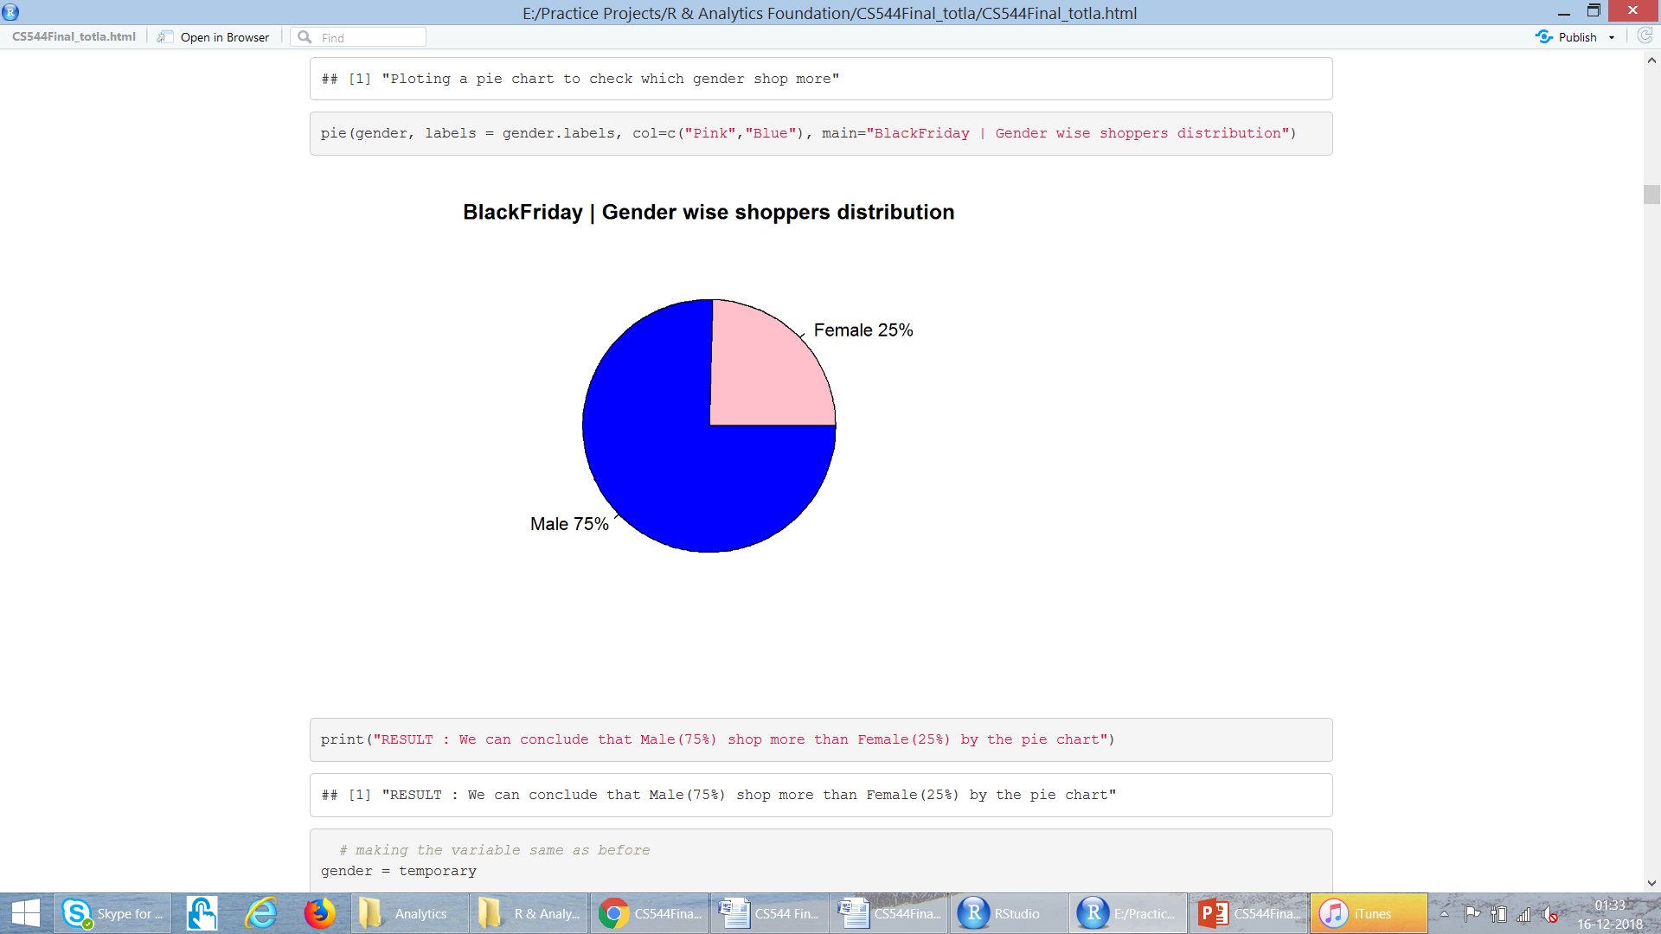
Analyse “Gender”

Slide 9
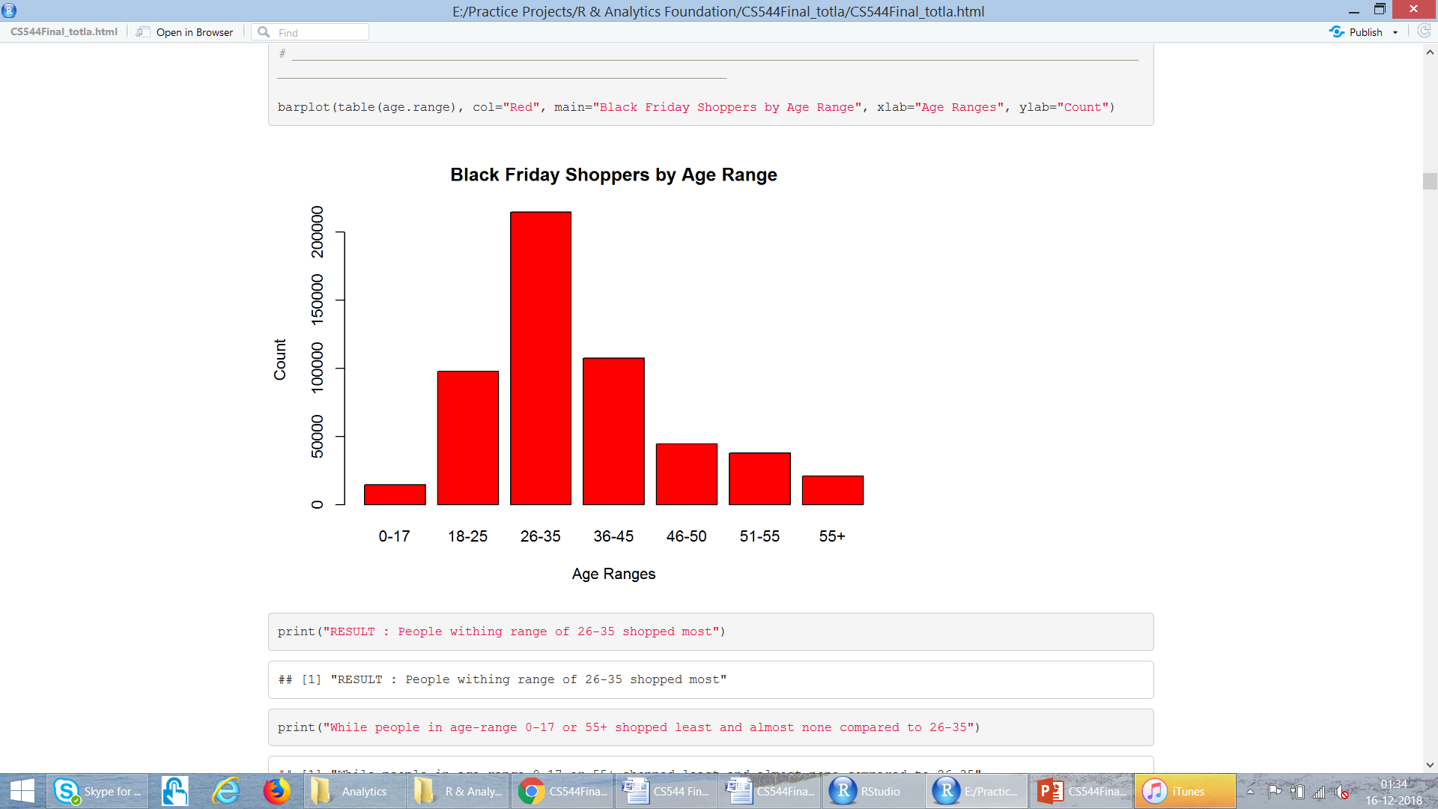
Analyse “Age-Range”

Slide 10
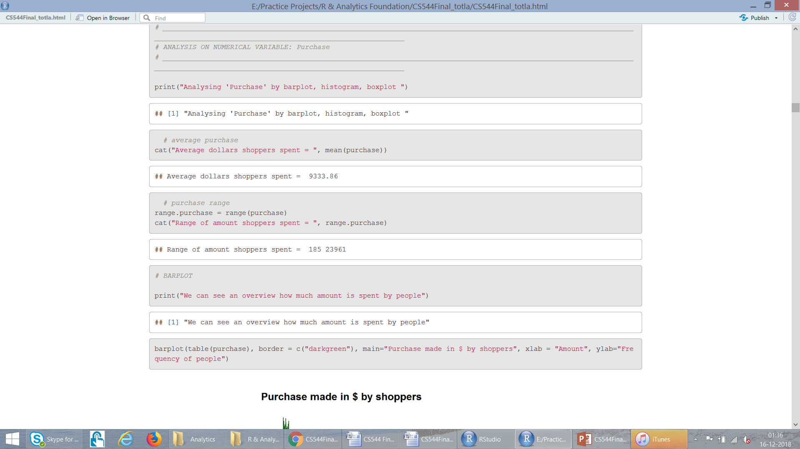
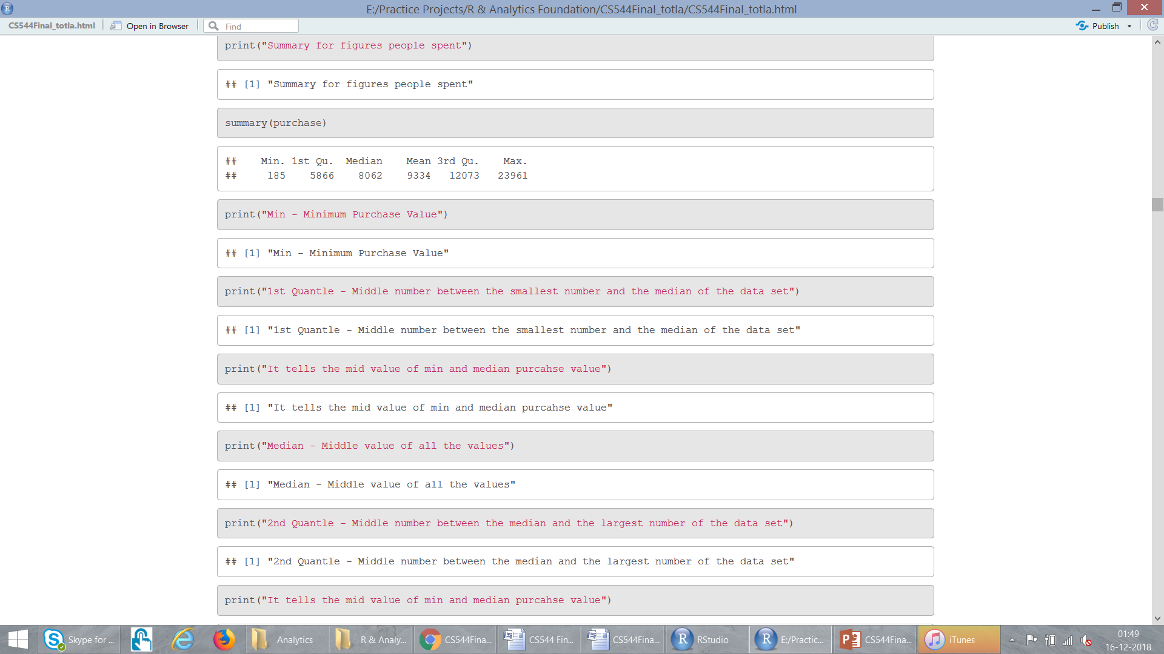
Analyse “Purchase”

Slide 11
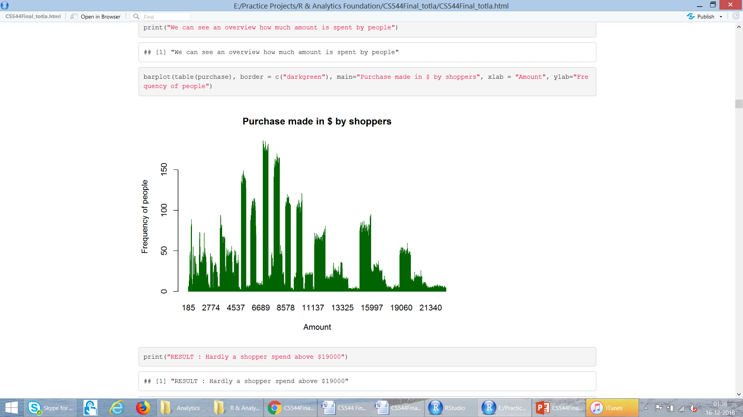
Analyse “Purchase” : Barplot

Slide 12
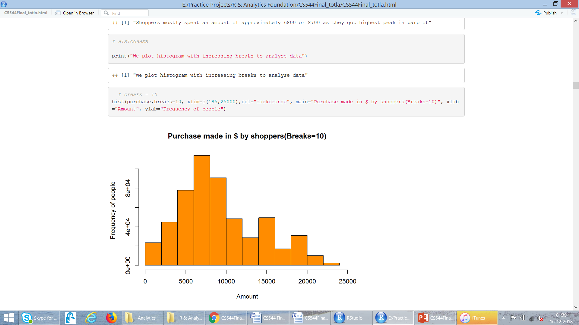
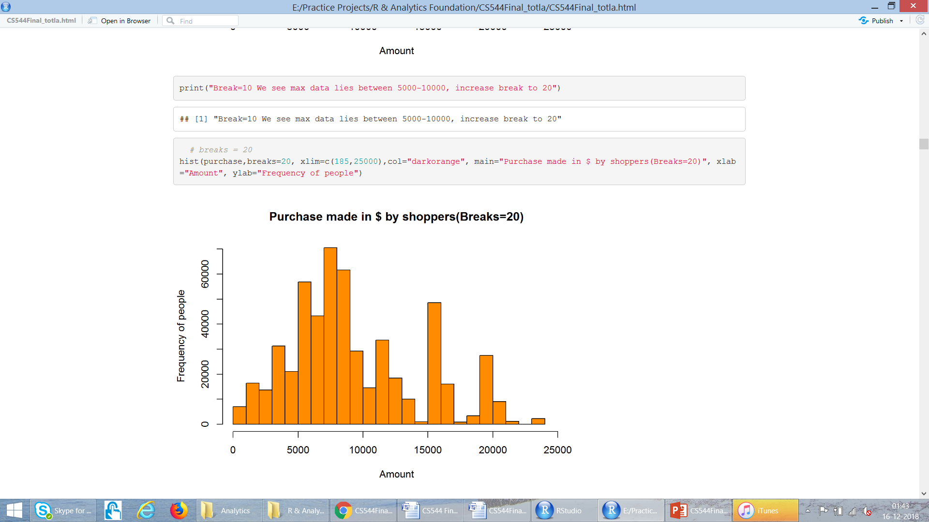
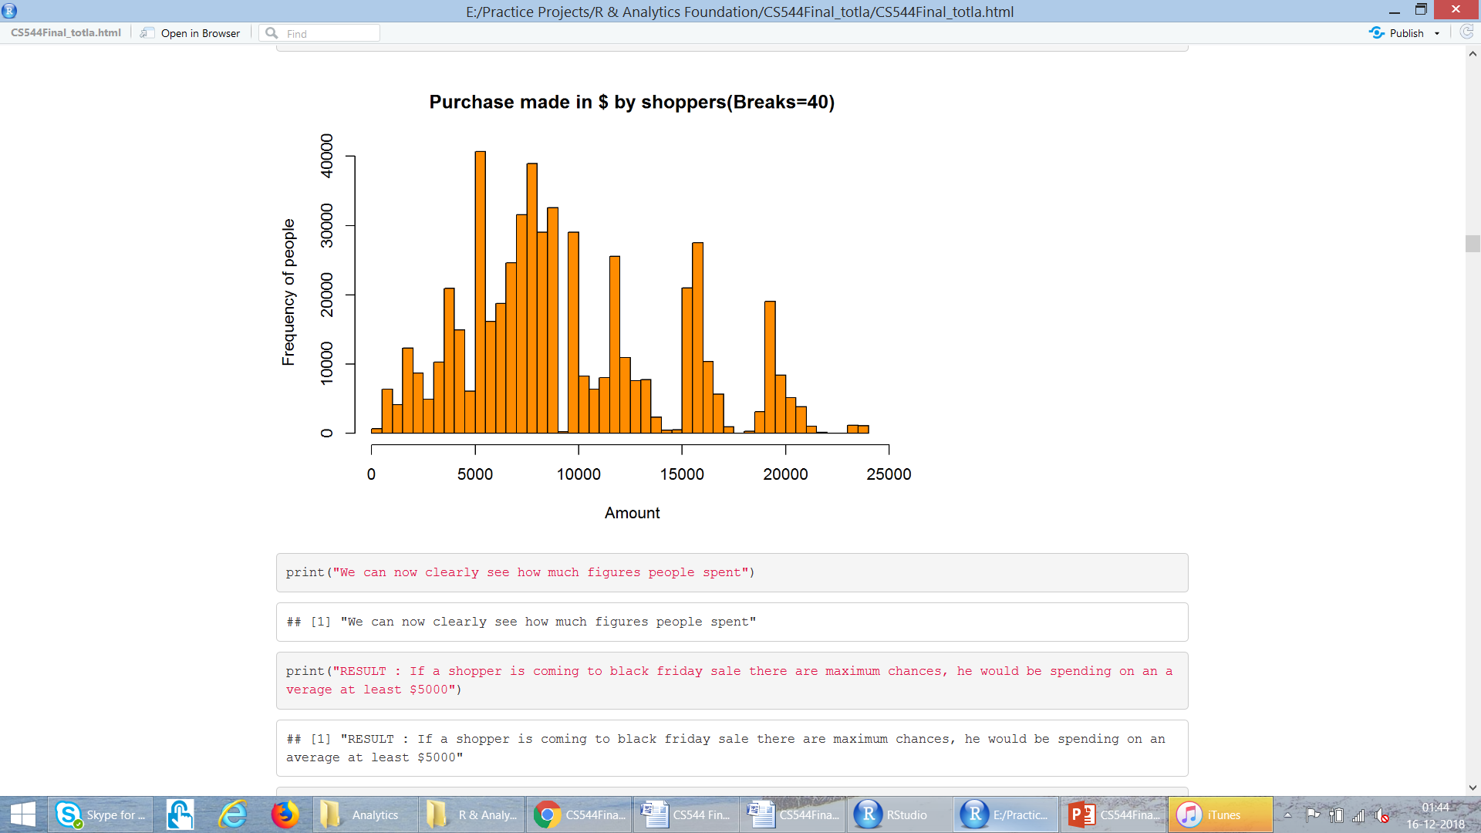
Analyse “Purchase” : Histograms

Slide 13
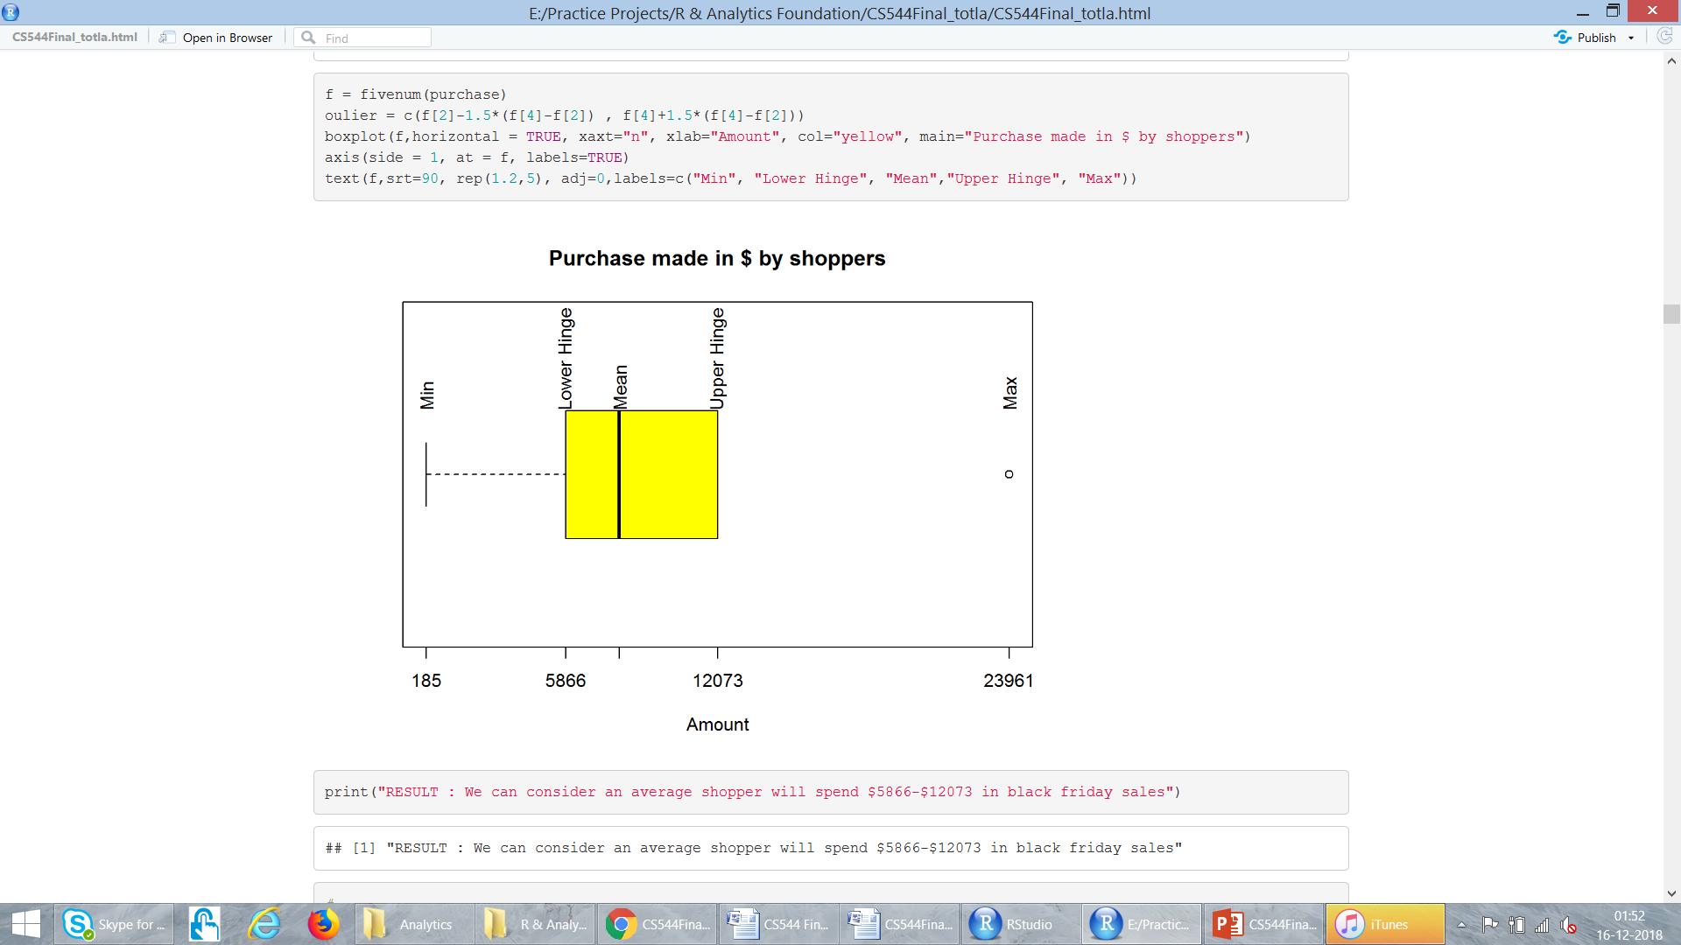
Analyse “Purchase” : Barplot

Slide 14
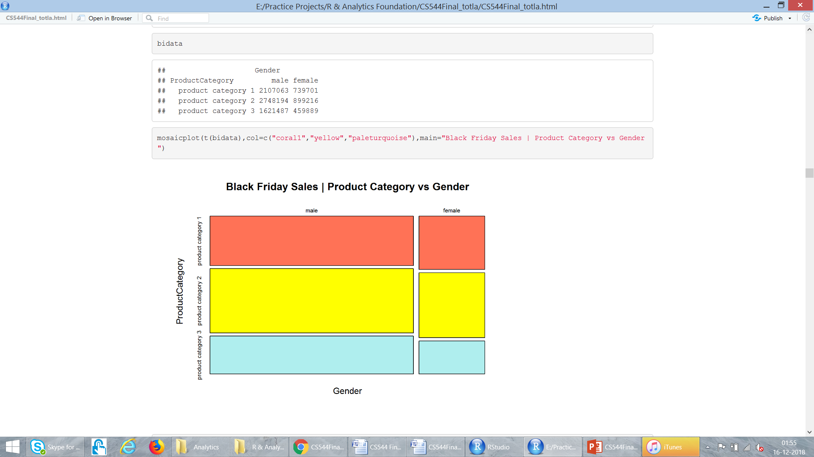
MULTIVARIATE DATA
Gender
Product Category 1
Product Category 2
Product Category 3

Slide 15
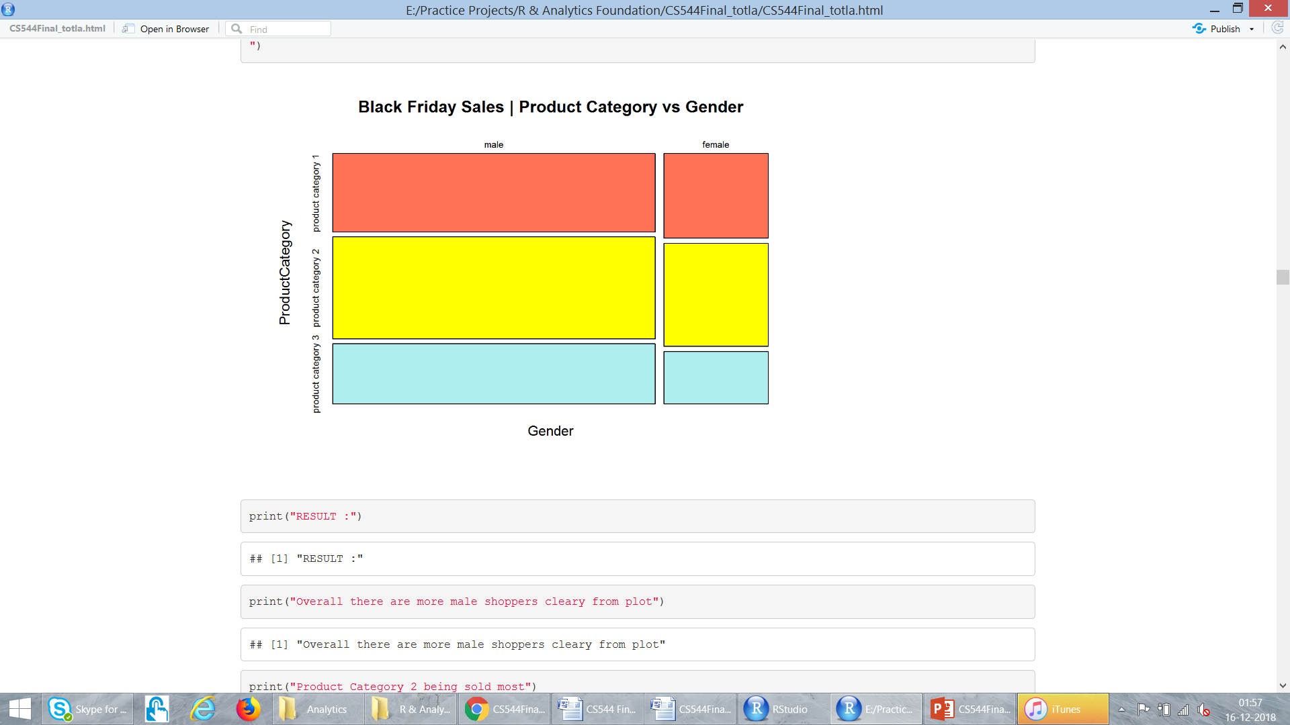
MULTIVARIATE DATA

Slide 16
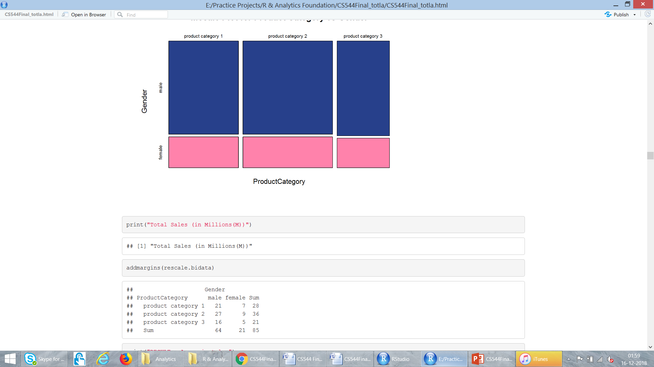
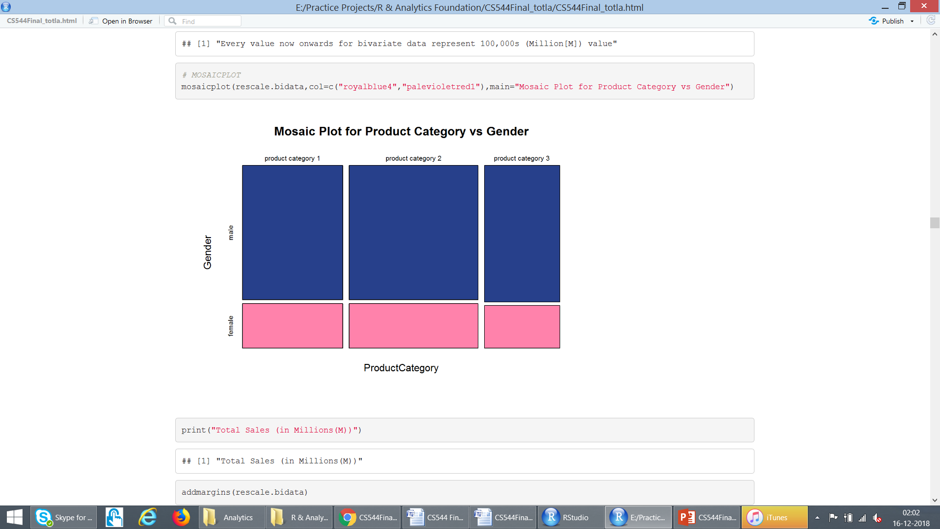
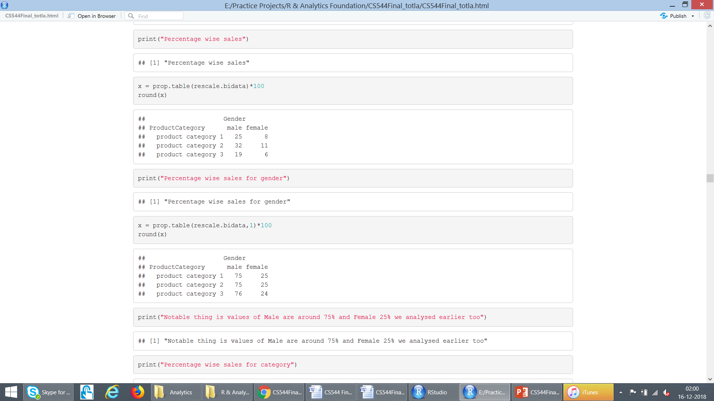
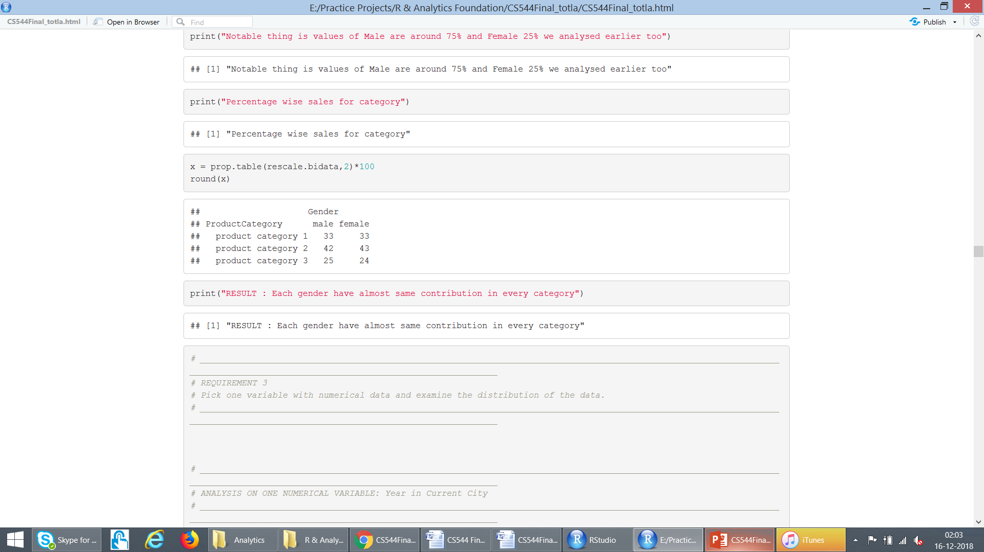
MULTIVARIATE DATA : Rescaled (values in Millions)
Overall
Gender
%tages
Product
Category
%tages

Slide 17
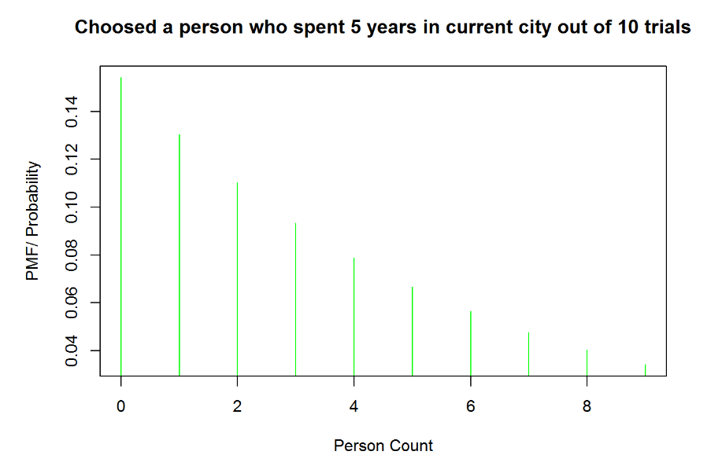
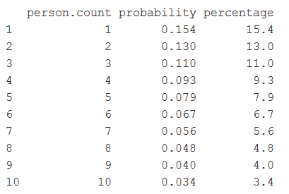
Analyse : “Years in Current City” Geometric Distribution

Slide 18
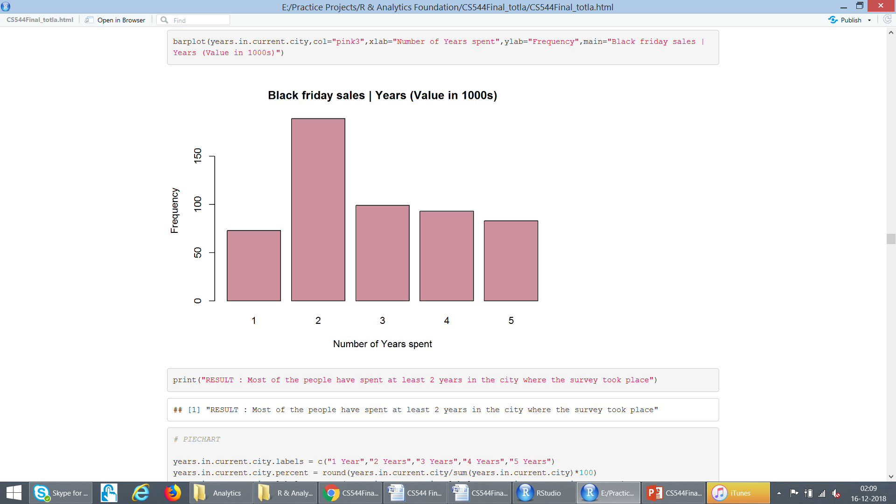
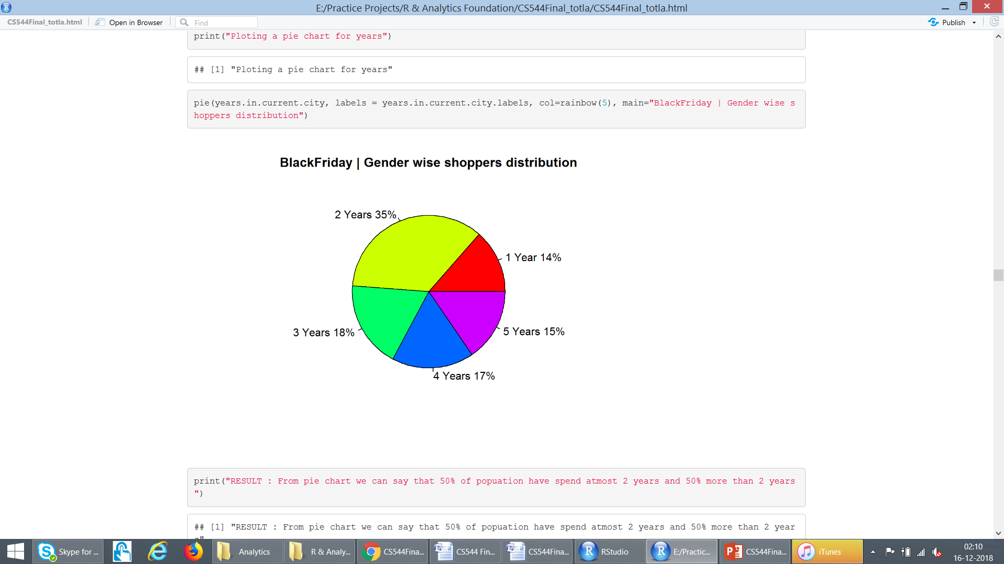
Analyse : “Years in Current City”

Slide 19
Central Limit Theorem
The mean of the sample mean distribution is equal to the mean of the parent data.
The higher the sample size, the narrower the spread of the sample means.
Sample Sizes : 0.5% 1% 5% 30% 75% of total purchases set
 | Original = 17959 | 0.5% = 90 | 1% = 180 | 5% = 898 | 30% = 5388 | 75% = 13469 | Average of samples
Mean | 9.35 | 9.49 | 8.83 | 9.52 | 9.39 | 9.41 | 9.32
Std Dev. | 4.99 | 4.96 | 4.99 | 5.19 | 5.04 | 4.94

Slide 20
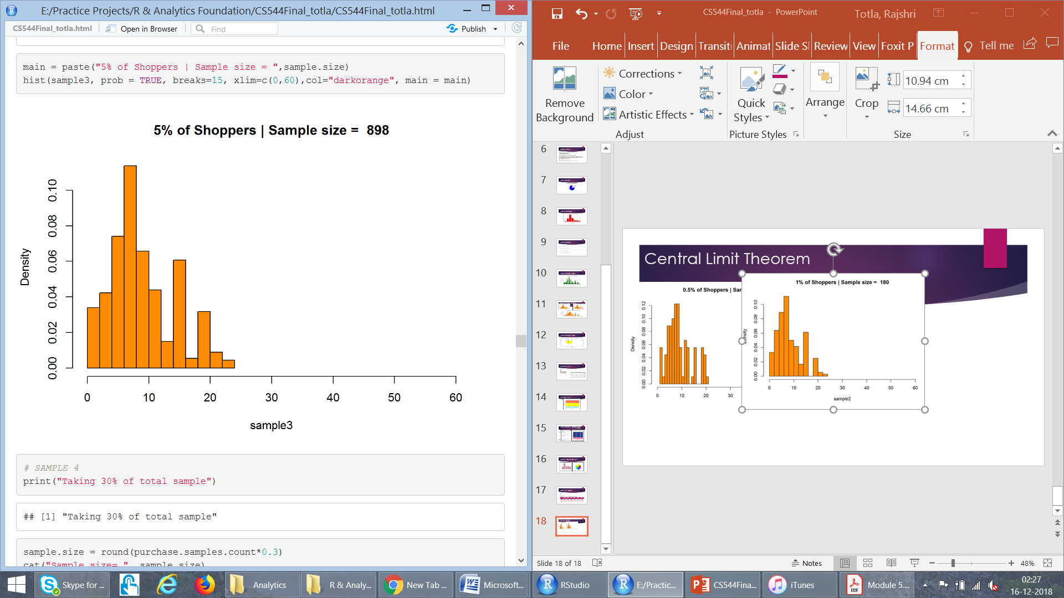
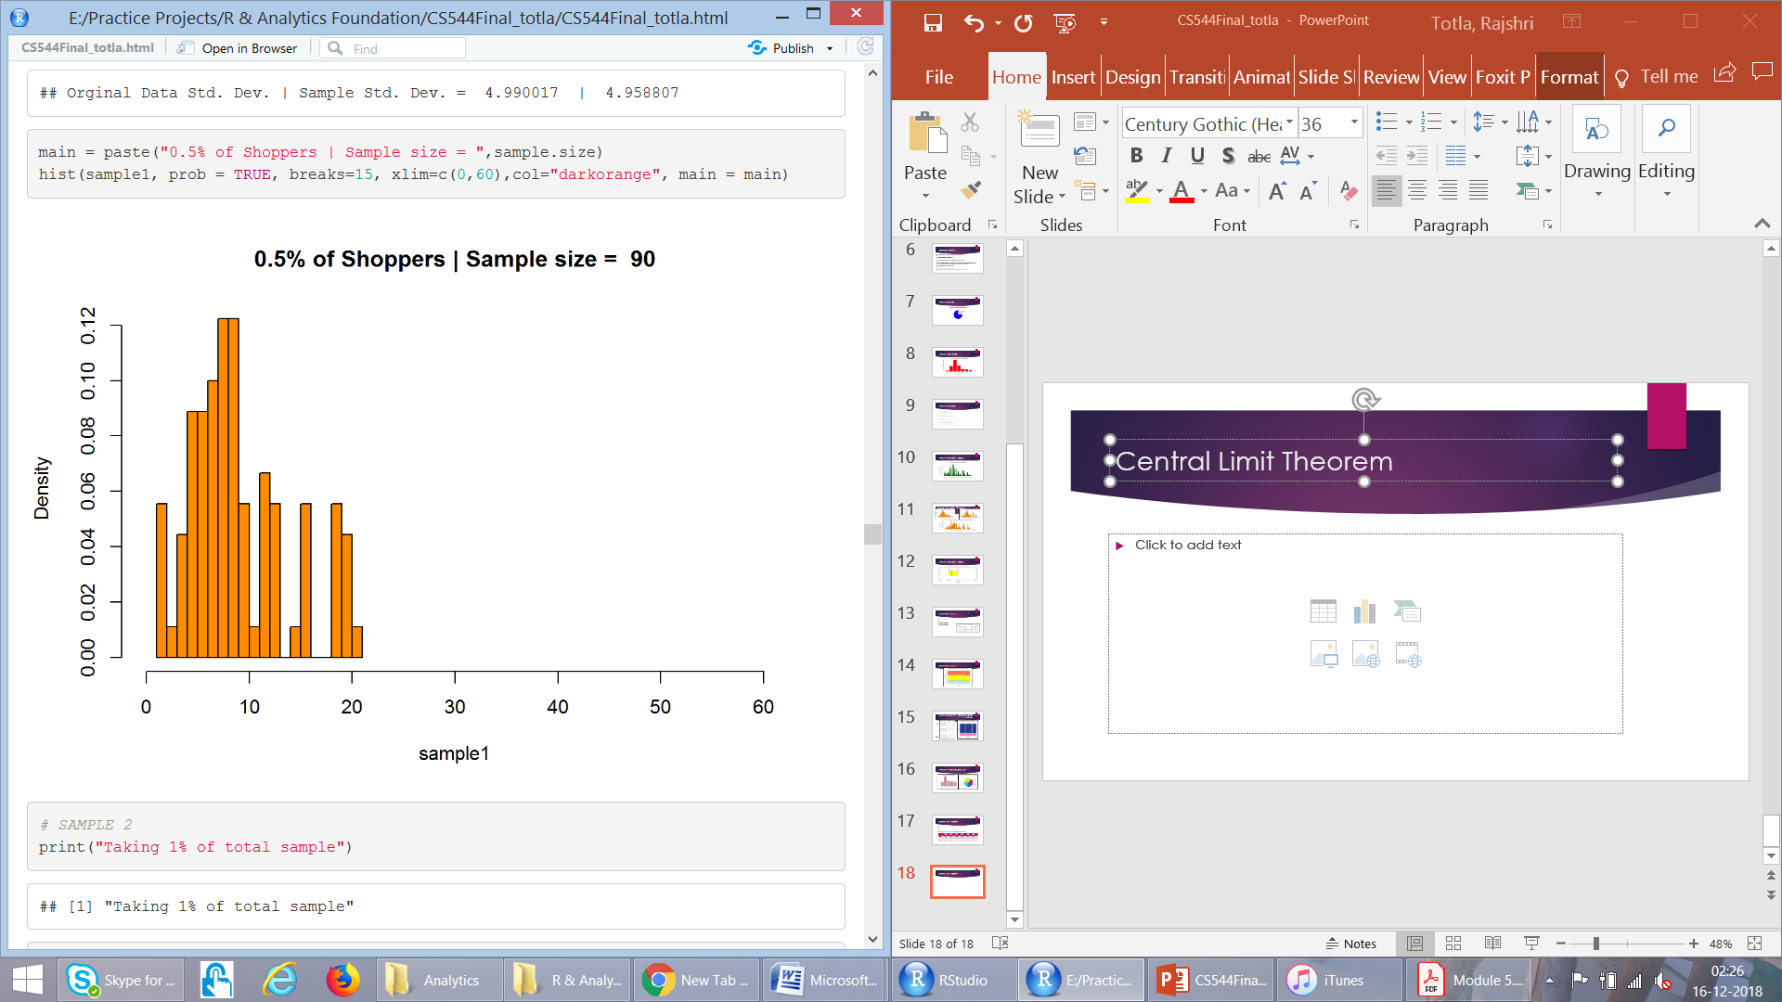
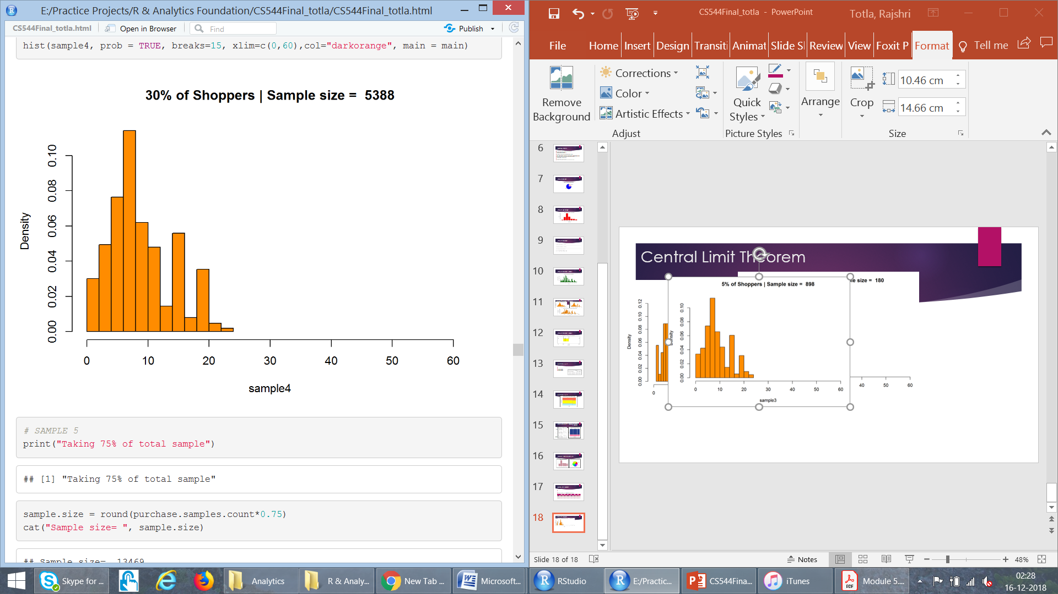
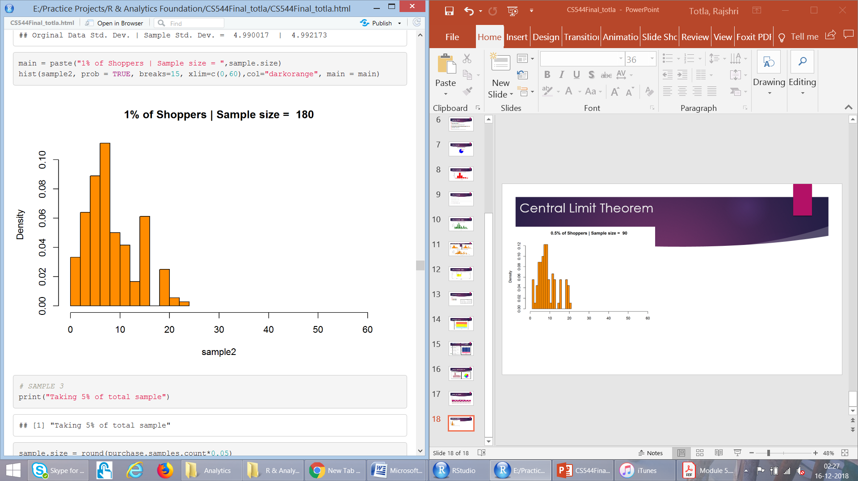
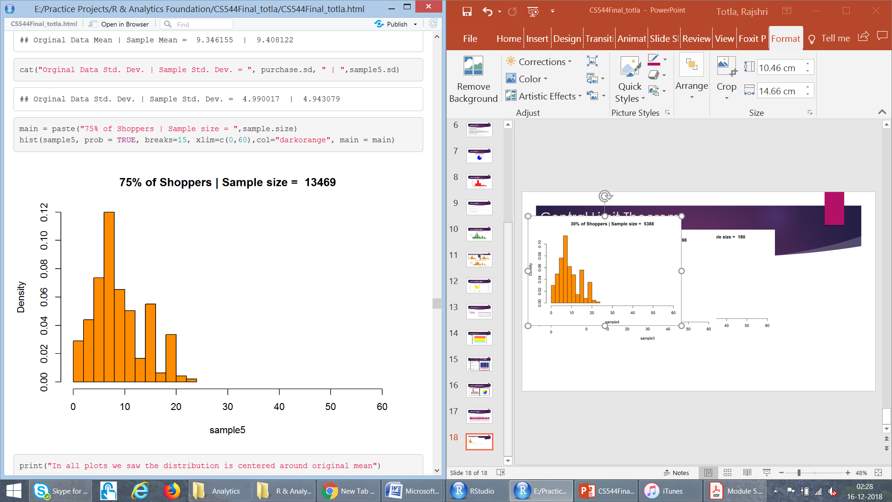
Central Limit Theorem

Slide 21
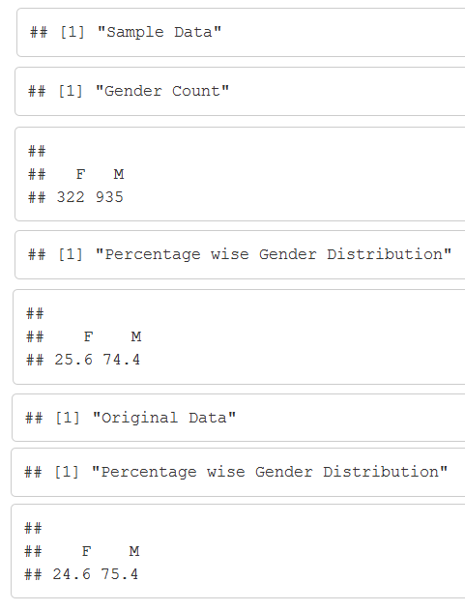
Simple Random Sampling : With Replacement

Slide 22
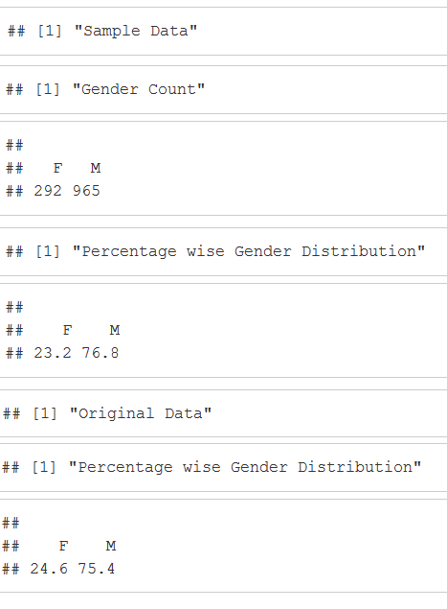
Simple Random Sampling : Without Replacement

Slide 23
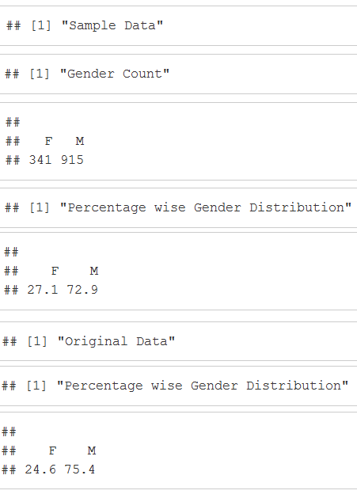
Systematic Sampling : Equal Probability

Slide 24
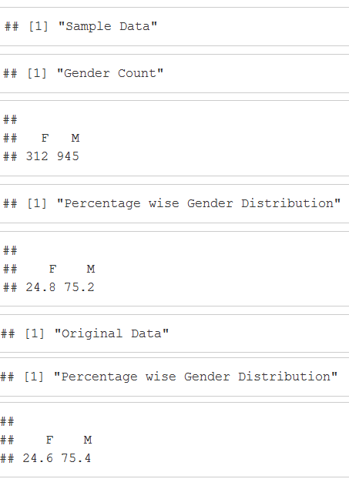
Systematic Sampling : Unequal Probability

Slide 25
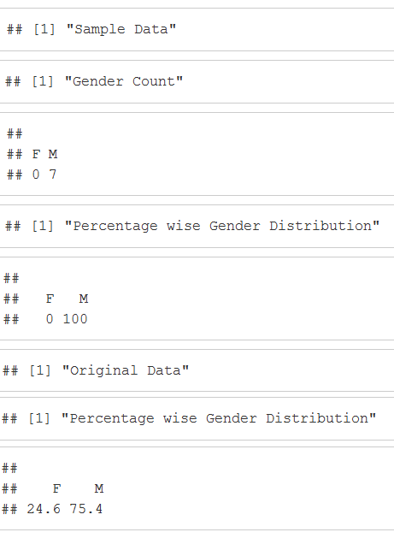
Stratified Sampling : Sample Size =10

Slide 26
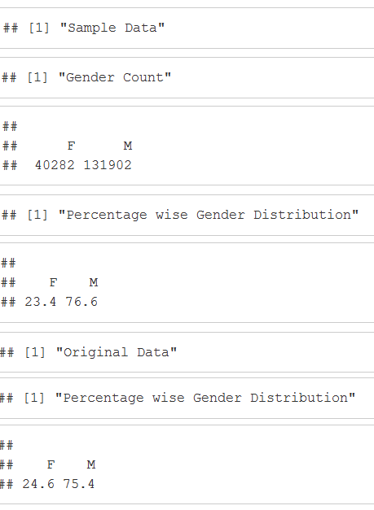
Cluster Sampling

Slide 27
Sampling
Therefore maximum change in original vs sample in:
Systematic Sampling : Equal Probability
Stratified Sampling : Sample Size =10
Almost similar interpretation
Systematic Sampling : Unequal Probability

Slide 28
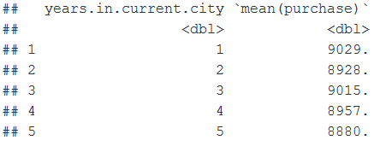
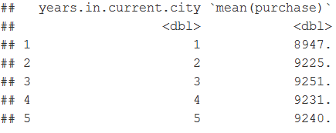
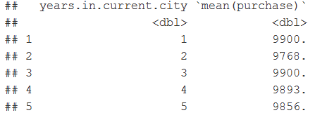
Other Observations (Used String/Tibble)
Average year a person live in following city:
A : 2.81
B : 2.88
C : 2.88
Average purchase in each city as per number of year :
A
B
C

Slide 29
Conclusion
Number of Male Shoppers > Female Shoppers
Products in Product Category 2 sold most
People generally spent over $5000 in sales
People in age range 26-35 purchase most
There are highest average sales in City Category ‘C’ as compared to other
Unequal Probability sampling technique could be used over this dataset for best results

Slide 30
Thank you!! Questions?

